Slide 1

DIGITALPATH INNOVATIONS Winning the Web: Unlocking Engagement, Conversions & User Satisfaction

Slide 2

Engagement Metrics Analysis

Slide 3

Engagement Metrics Analysis
Average Time Spent
Version A (5 mins) > Version B (3.3 mins)
Users are spending significantly more time on Version A, suggesting it is more engaging or easier to navigate.
Possible reasons: better content, improved user interface, or more intuitive design.

Slide 4
Engagement Metrics Analysis
Average Pages Viewed
Version A (10 pages) > Version B (5 pages)
Users explore twice as many pages in Version A, indicating better content flow or more compelling CTAs (calls to action).
Possible reasons: stronger internal linking, clearer navigation, or more engaging content structure.

Slide 5
Engagement Metrics Analysis
Average Actions Taken
Version A (4.9 actions) ≈ Version B (5 actions)
The number of actions taken is nearly the same, meaning both versions drive similar interaction levels.
Despite users spending more time and viewing more pages in Version A, Version B still encourages comparable action-taking efficiency.

Slide 6

Conversion Rate Optimization

Slide 7

Conversion Rate Analysis
Overall Conversion Rate
Version A (70.5%) > Version B (38.2%)
Version A significantly outperforms Version B in conversions, suggesting that it provides a smoother or more compelling journey from engagement to action.
Possible reasons: better CTAs, more persuasive copy, more intuitive checkout process, or reduced friction in completing purchases.

Slide 8
Conversion Rate Analysis
Product Views
Despite Version B having slightly higher product views, it has a much lower overall conversion rate.
This suggests that while users browse products in both versions, they may not find Version B as compelling to proceed with a purchase.

Slide 9
Conversion Rate Analysis
Cart Additions
Version A (71.5%) < Version B (72.6%)
Version B slightly outperforms Version A in getting users to add items to their cart, but this does not translate into more completed purchases.
Possible issue: Users may be hesitant to complete the purchase in Version B due to trust factors, unclear pricing, or friction in the checkout process.

Slide 10
Conversion Rate Analysis
Checkout Completion Rate
Version A (62.8%) > Version B (61.4%)
Both versions have similar checkout completion rates, meaning once users reach this stage, they tend to finish the process.
The main challenge for Version B is not checkout abandonment but getting users from browsing to committing to a purchase.

Slide 11
Conversion Rate Analysis
Final Takeaway
Version A is currently the clear winner in terms of conversion performance.
However, Version B has potential, as it gets users to browse and add to cart but struggles with commitment.
Optimizing the purchase journey in Version B could help improve its conversion rate while maintaining user engagement.

Slide 12

User Insights Analysis

Slide 13
User Insights Analysis
.Feedback Submissions
Version A (18.7%) > Version B (17.9%)
While both versions have a similar level of feedback submissions, Version A slightly outperforms Version B.
This suggests that users in Version A might be more engaged and willing to provide feedback, possibly due to a better user experience.

Slide 14
User Insights Analysis
Content Interaction (Videos Watched)
Version A (49.8%) < Version B (52.0%)
Users on Version B are watching slightly more videos than those on Version A, which suggests that Version B may have better video placement, more compelling video content, or a stronger focus on multimedia engagement.
However, despite higher video engagement, Version B still lags in conversions and overall satisfaction.

Slide 15
User Insights Analysis
Referral Source Impact
Direct Traffic:
Users arriving directly engage more with Version A, indicating stronger retention or brand familiarity.
Search Engine Traffic:
Version B attracts more search traffic, but these users spend less time, suggesting they might not find what they need or exit quickly.
Social Media Traffic:
Version A retains social media visitors better, meaning its design or messaging resonates more effectively with socially-driven users.

Slide 16
User Insights Analysis
Average Ratings
Version A (4.5/5) > Version B (3.0/5)
This is a significant difference, showing that users clearly prefer Version A in terms of overall experience.
This could be due to better design, easier navigation, clearer messaging, or an overall smoother purchasing process

Slide 17

Recommendations

Slide 18
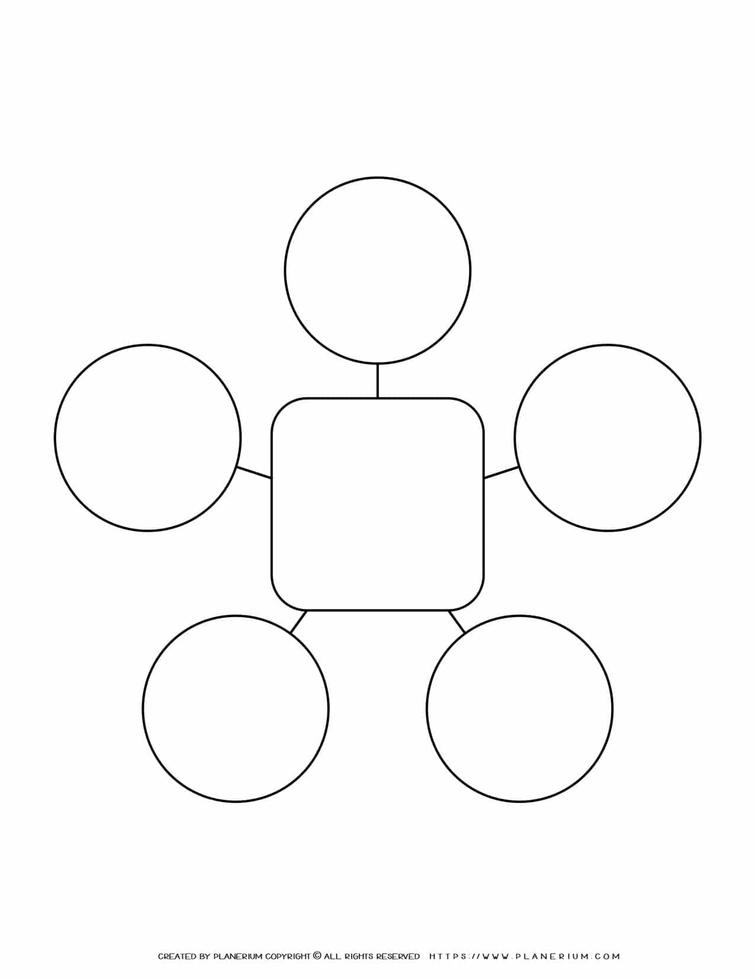
Recommendations
Version A consistently outperforms Version B in engagement, conversions, and user satisfaction.
It has:
Higher time spent per session (5 min vs. 3.3 min)
More pages viewed (10 vs 5)
Significantly higher conversion rate (70.5% vs. 38.2%)
Better user ratings (4.5/5 vs. 3.0/5)
Retain and Optimize Version A as the Primary Webpage
Leverage Video Content for Higher Engagement
Address Version B’s Key Weaknesses & Integrate A’s Strengths
Action Plan
Strengthen Traffic Acquisition & User Retention
Enhance Conversion Optimization Strategies

Slide 19

Final Takeaway
✅ Version A should be the foundation for further improvements.
✅ Version B needs refinement—it has strengths (video engagement & search traffic) but struggles overall.
✅ Focusing on conversions, traffic retention, and continuous testing will help DigitalPath Innovations maximize its website’s impact.

